Slide 1
COMP0118 Analysis of MRI T2 Relaxometry
Francesco Seracini – Chongpo Shao – Pragya Sinha – Ethan Stephenson – Xinyu Tian

Slide 2
MRI T2 Relaxometry for preterm born infants

Slide 3
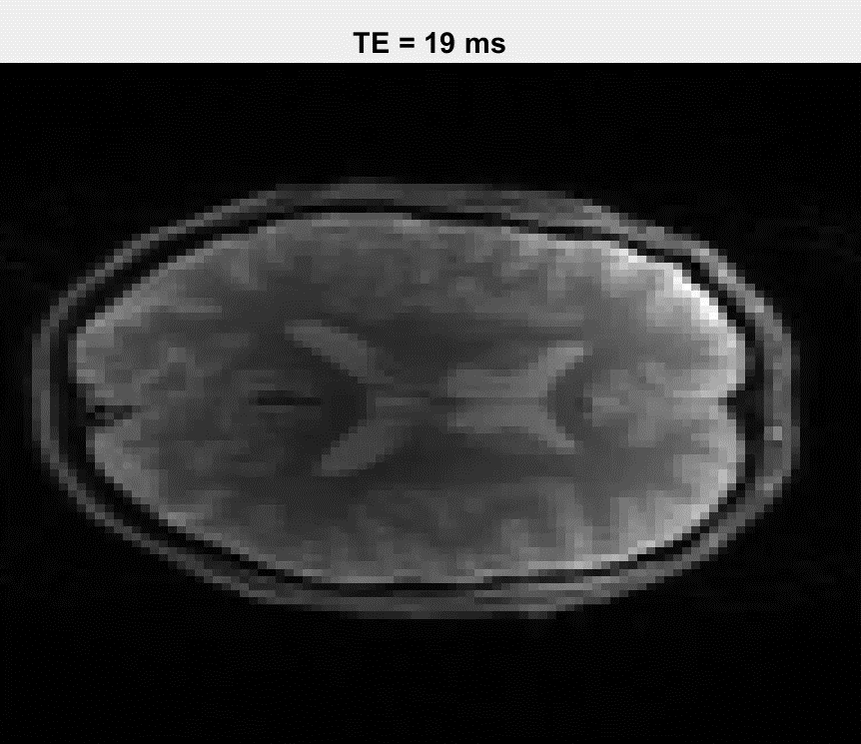
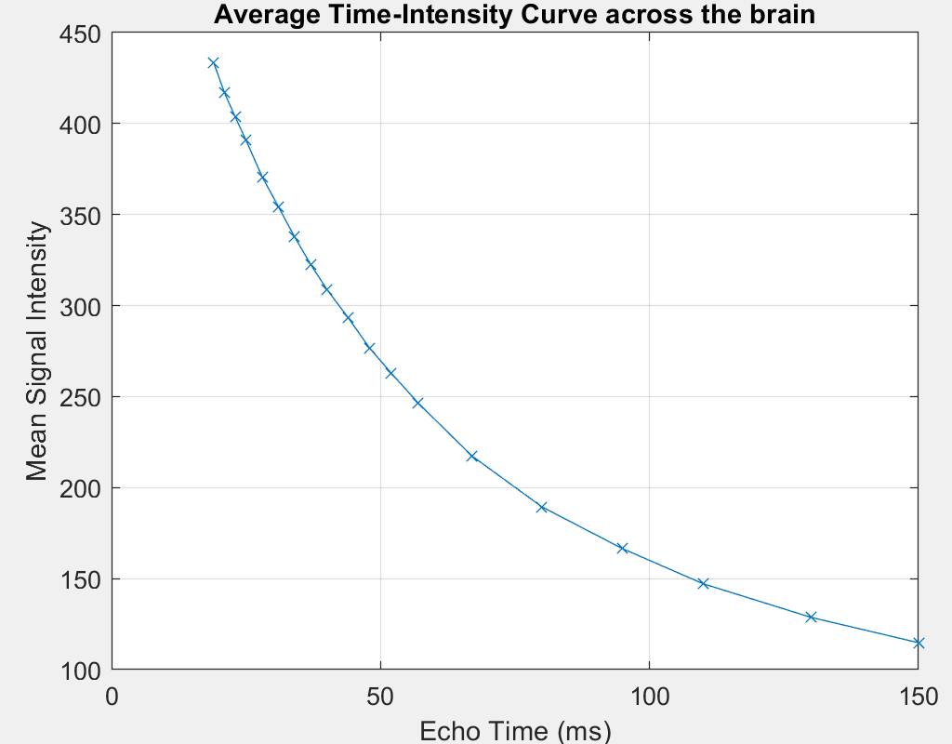
T2 Decay

Slide 4
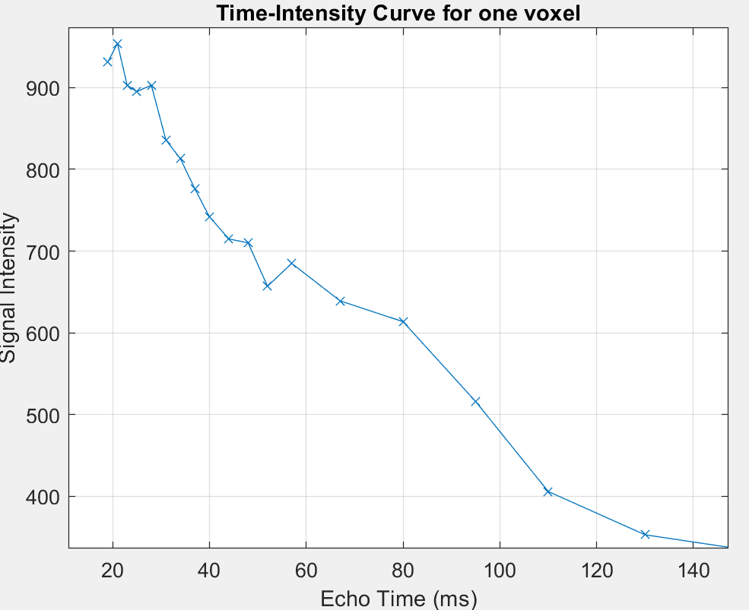
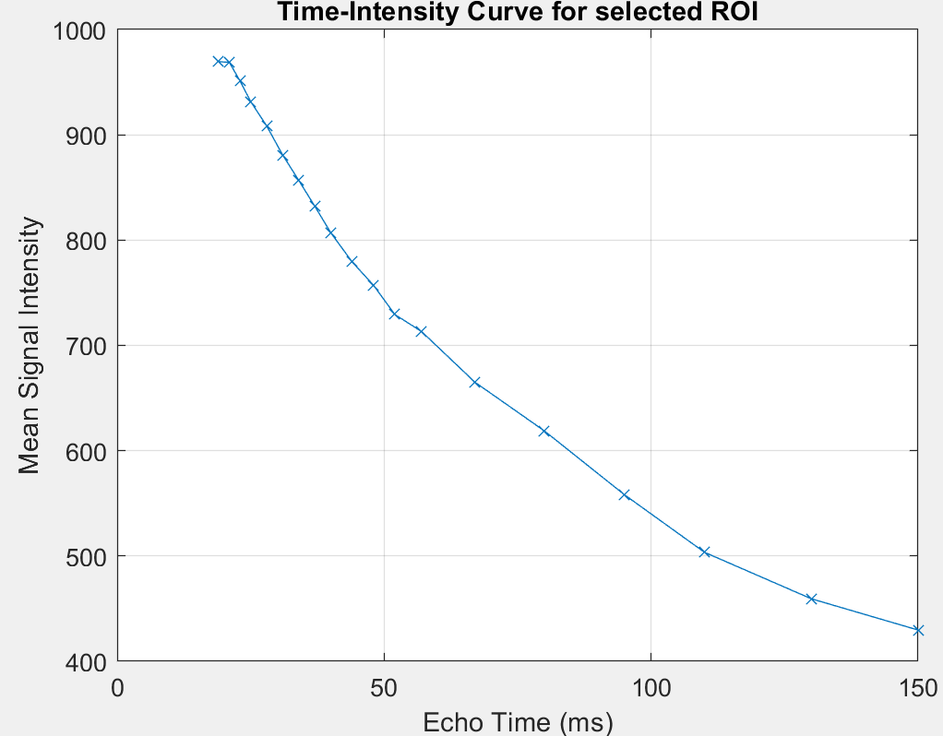
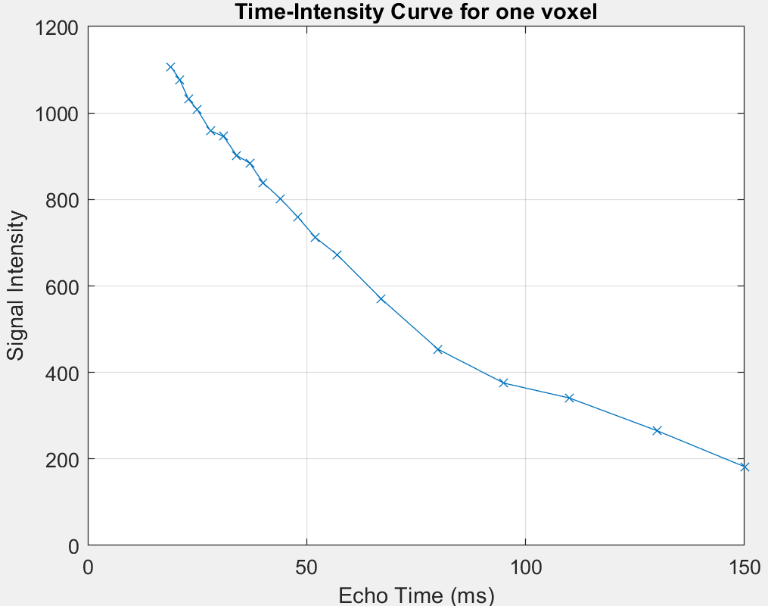
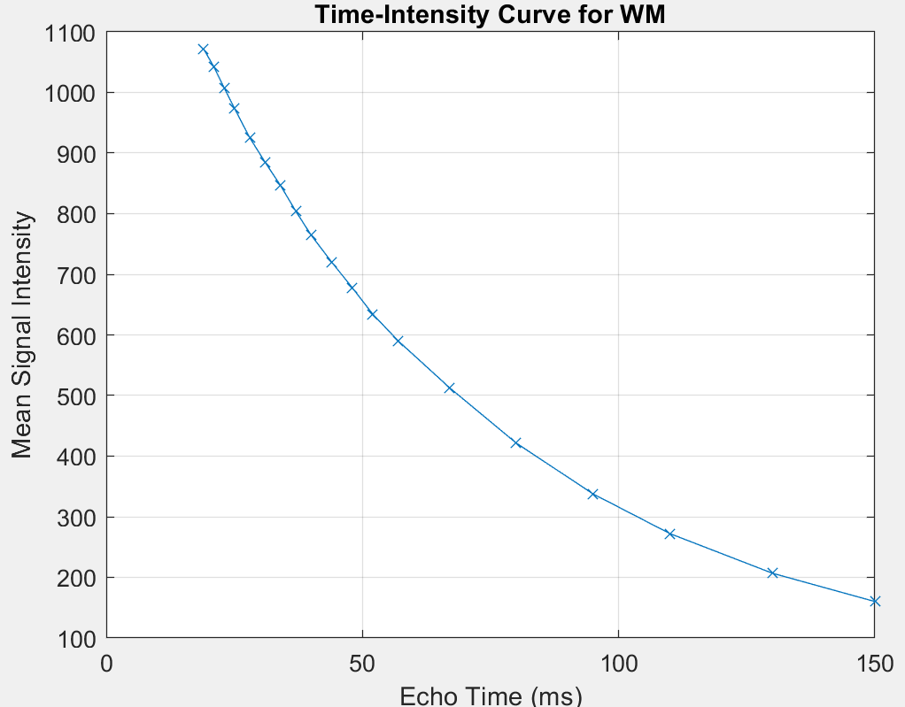
Image Acquisition Problems
Noise
Patient motion
Different tissue compartments

Slide 5
T2 Estimate
ALGORITHM | ERROR | COMPUTATIONAL TIME | SCORE
Two Points
Linear Least-Squares
Weighted Least-Squares
Non-Linear Least-Squares
Non-Negative Least-Squares
Here images of T2 maps

Slide 6
Two compartments model
Voxels containing a mixture of different tissues, do not conform to a single-exponential model
Here T2 and v maps
$$S\left(TE\right)= S_{0}\left[v_{1}∗ e^{\left\{−\frac{TE}{T2_{1}}\right\}}+ \left(1 − v_{1}\right)∗ e^{\left\{−\frac{TE}{T2_{2}}\right\}}\right]$$
STRUCTURE | T2_1 AVERAGE | T2_2 AVERAGE | v AVERAGE | T2_1 STD | T2_2 STD | V STD
CSF
GM
WM

Slide 7
Models comparison
Here the residuals maps of the 2 compartments and of the best 1 compartment. Each one with the error value under it
MODEL | AIC | BIC

Slide 8
Further research directions
More compartments
Improve the fitting in presence of noise
Differences between preterm and full term infants

